Slide 1
L2 Security
EN.600.444/644
Spring 2019
Dr. Seth James Nielson

Slide 2
Overview of Ethernet
Inspired by AlohaNet (a wireless protocol!)
Originally, a shared medium with collision detect
Modern ethernet (e.g., Gig Ether) has no collisions
Technically, the messages are called “frames”
Actually have a layer 1 and layer 2 component!
Also include “ethertype” which says what kind of data

Slide 3
L2 Communication
Mac Addresses
Broadcast support
ARP – map MAC to IP address

Slide 4
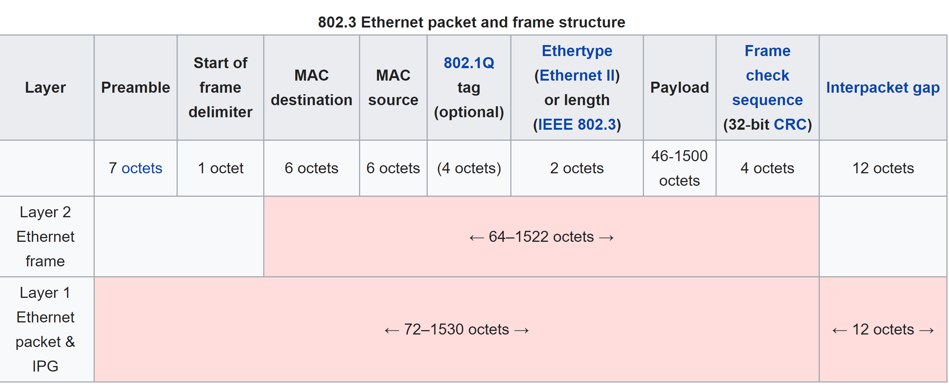
Ethernet Type II Frame

Slide 5
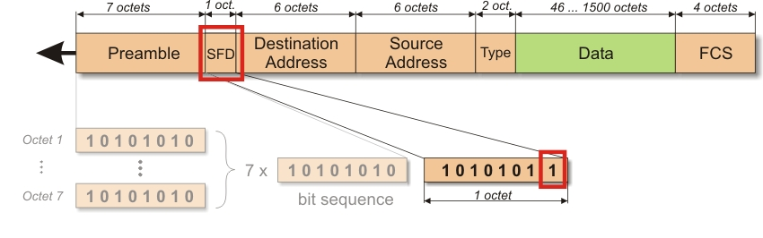
Preamble

Slide 6
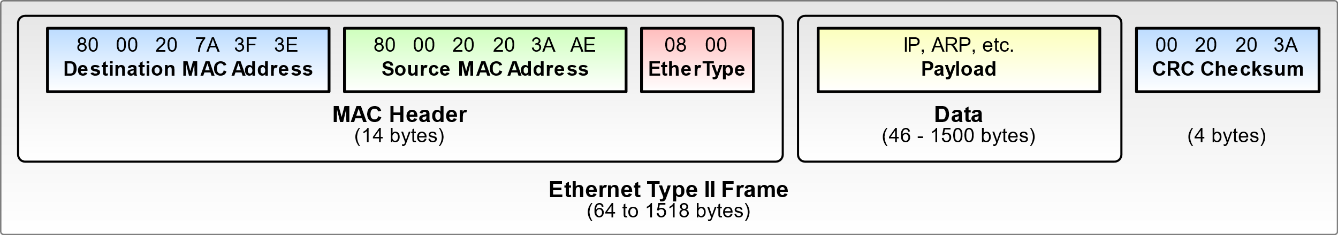
Ethernet Frame

Slide 7
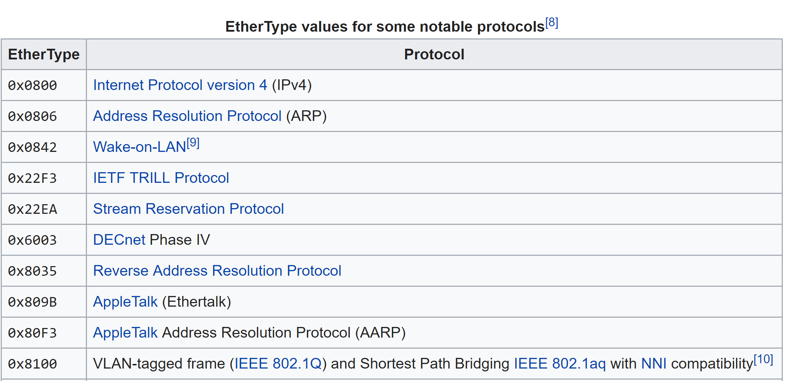
Common EtherType’s

Slide 8
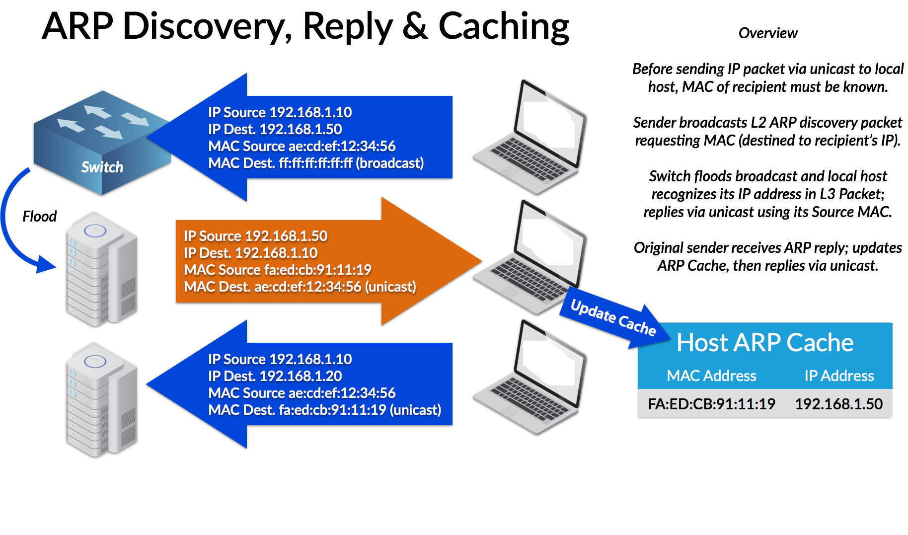
Address Resolution Protocol

Slide 9
L2 Threat: ARP Poisoning
Address Resolution Protocol
ARP request broadcast asks for IP address
Node responds saying, “That’s me!”
Other nodes record the message in “ARP Cache”
False response is called “poisoning”

Slide 10
Attacks
Man-in-the-Middle (MITM)
Intercept communications meant for another principal
Screw up SDN
DoS – Change packets to mess with communications
Can also screw up SDN

Slide 11
Defenses
Attacker must be connected to the local network
Static ARP caches (small networks only)
One-mac address per switch port
MACsec
Complex key management problems
Does not stop a “legitimate” user from sending bad ARPs
Does make it auditable, however.

Slide 12
Port Stealing
Flood switches with ARP packets to change port mapping
Ethernet, remember ,no longer does share media
Instead, ports map to MAC addresses
Attack:
Convince the switch that your computer owns target’s port
After data is received, allow victim to take back port

Slide 13
VLAN’s
VLAN – Virtual LAN
Typically uses a special TAG in the Ethernet frame
May be on one or more physical LAN segments
Creates a broadcast domain
Traffic cannot move from one VLAN to another without routing

Slide 14
VLAN Security
Can reduce ARP attacks because ARP traffic is bounded
However, has its own weaknesses and attacks
Abuse Dynamic Trunking Protocol to be part of all VLAN’s
VLAN hopping using double tagging

Slide 15
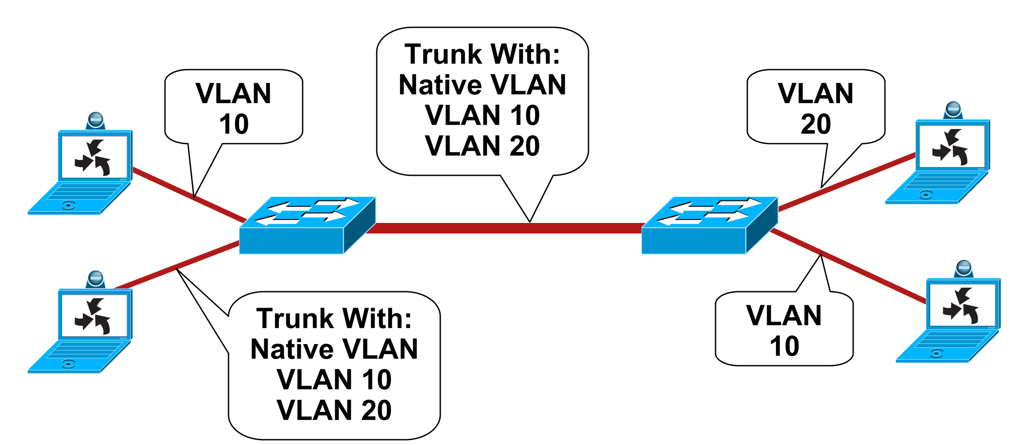

Slide 16
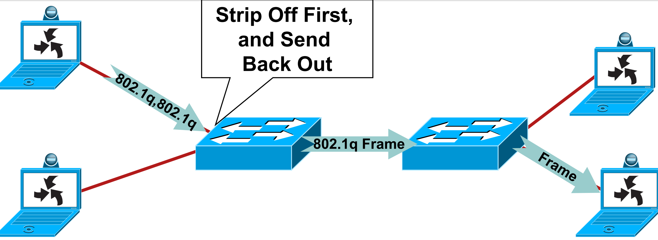

Slide 17
VLAN Security
Don’t use VLAN -1 (Native)
Dedicated VLAN ID per port,
Disable DTP on “user facing” ports
Disable unused ports, put them in unused VLAN

Slide 18
DHCP
Request an IP address dynamically
Sent over L2, of course, because no IP address yet

Slide 19
DHCP ATtacks
Gobbler: Request ALL DHCP ADDRESSES!
MITM: Pretend to be DHCP server
Give false gateway, get control of routes

Slide 20
General Concerns for L2
Who owns L2 security?
Physical security of ports is often non-existant

Slide 21
Layer 2 Firewall
Can insert a firewall WITHOUT an IP address
Must be used at a bridge point in the network
Sometimes this is done where a VPN connects
But can be used between any partition
Firewall still inspects all the traffic (up to L7)
Cannot be “targeted” (or even seen!) by attackers

Slide 22
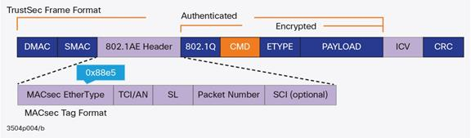
MACSec Frame

Slide 23
MACSec Frame Details
EtherType – 0x88E5
TCI – TAG control info, such as version number, features
AN – Association Number, identifies security association
SL – Short Length (if length is less than 48)
Packet Number – Used for IV/prevent replay
SCI – Secure Channel Identifier for optional station ID

Slide 24
MACSec Advantages
Data decrypted at each hop
Permits examination of data for security scanning

Slide 25
MACsec Key Agreement
Preshared Keys
The master session key which is a product of a successful Extensible Authentication Protocol (EAP) authentication
Key distributed from an MKA key server

Slide 26
MKA Keys
MACSec Key Agreement Protocol (MKA) – Discovery, Keys
Connectivity Association Key (CAK) – Master key (shared)
Pre-shared
Or EAP
Connectivity Associations (CA) – CA if share same CAK
Secure Association Key (SAK) – Session Key
Key Server – Elected peer that distributes SAK’s

Slide 27
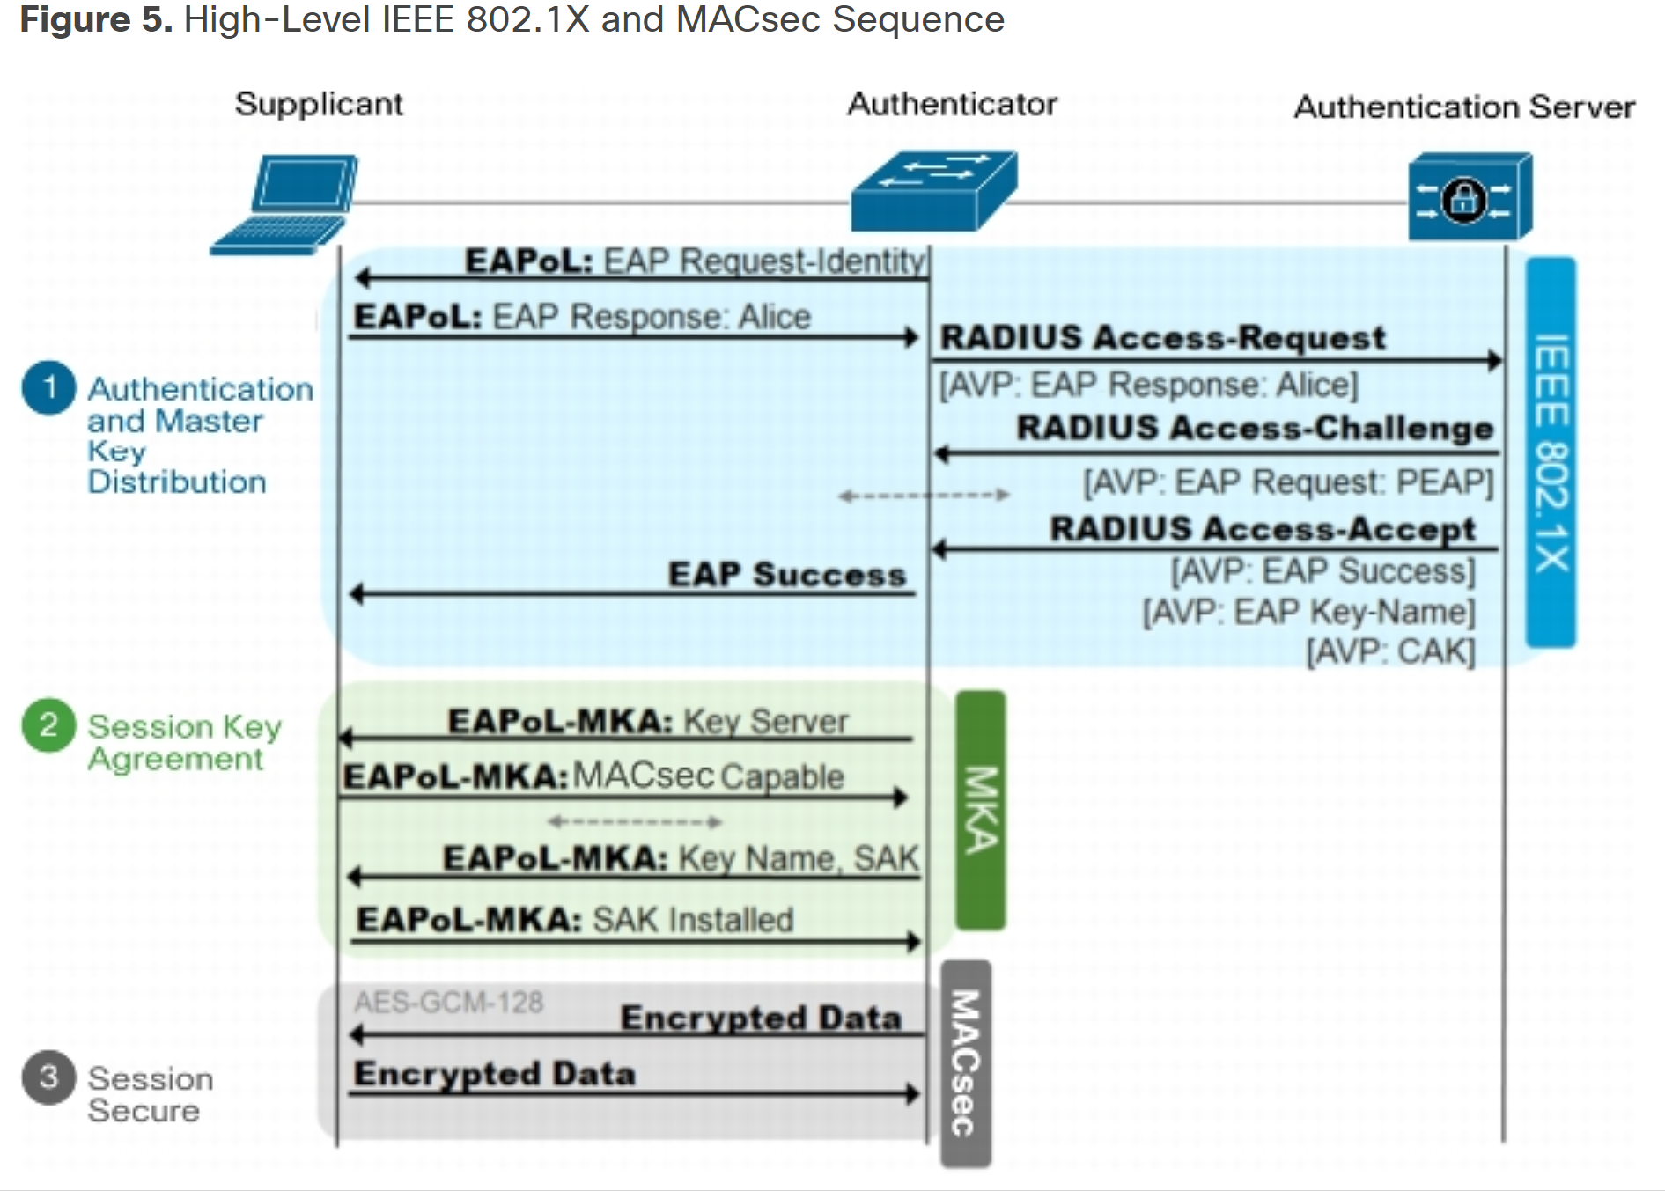
EAP Auth

